Slide 1
DevOps Traning
Swarm Mode

Slide 2
Swarm Mode : New Problems
How do we Automate the container Lifecycle
How can we easily scale out/in/up/down?
How do we ensure our Containers are re-created if they fail?
How do we replace Containers without Downtime(Blue/Gree Deployments)?
How to track/control where containes get started?

Slide 3
Swarm Mode : New Problems
How do we create cross node virtual networks?
How can we ensure only trusted servers run our contaniers?
How can we store secrets, keys, passwords and get them to the right container?

Slide 4
Swarm Mode
Swarm mode is clustering solution built inside Docker.
Swarm Brings together Different OS/Host/Nodes into single manageble Unit.
Not related to SWARM “Clasic” for pre-1.12 versions
Added in 1.12(Summer 2016) via SwarmKit

Slide 5
Swarm Mode
Enhanced in v1.13(Jan 2017) via Stacks and Secrets
Not Enabled by default, new commands once enabled
docker swarm
docker node
docker service
docker stack
docker secret

Slide 6
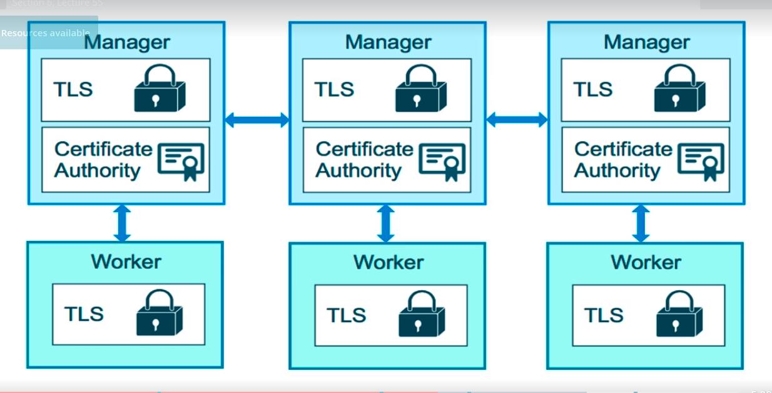
Swarm Mode

Slide 7
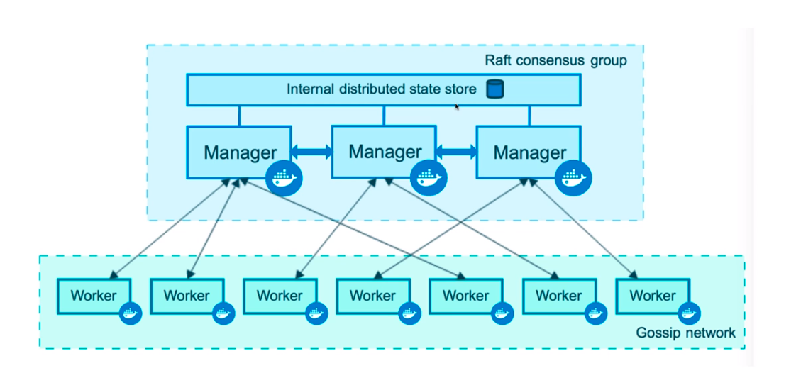
Swarm Mode

Slide 8
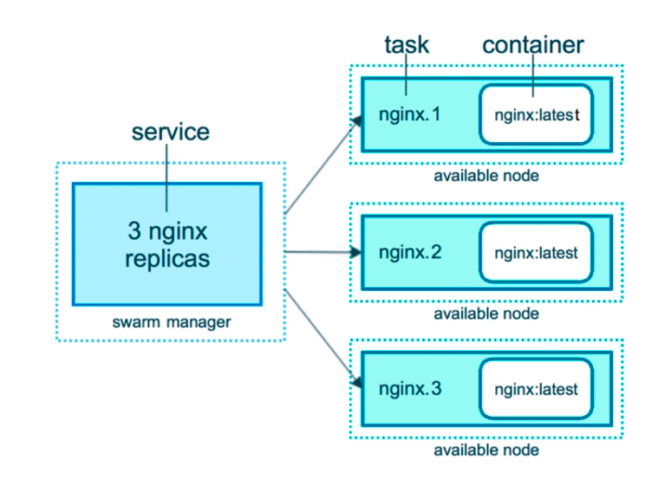
Swarm Mode

Slide 9
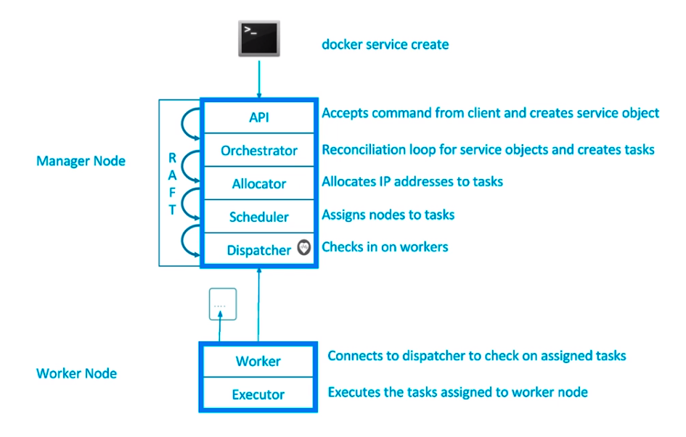
Swarm Mode

Slide 10

DevOps Training : Docker
Thank You

